Slide 1

TEAM 4
JANE’S FLOWER SHOP PROBLEM

Slide 2

TEAM MEMBERS
AVUTHU GANGADHAR REDDY
TANGUTURI RUKESH REDDY
DHARSON T
VUTUKURU HEMANTHA KUMAR REDDY
VANSH KAPOOR

Slide 3
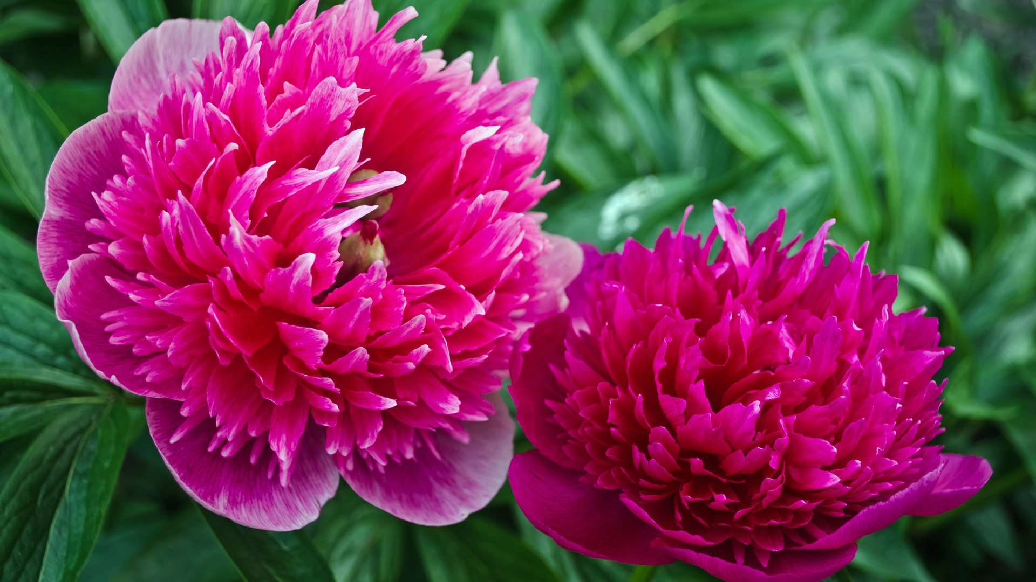
INTRODUCTION
Jane plans to open a flower shop in the local flower market. The initial cost includes the booth license, furnishings and decorations, a truck to transport flowers from the greenhouse to the shop, and so on. Jane will have to recoup these costs by earning income. She has estimated how much net income she will earn in each of the following M months . Jane wants to predict how successful her flower shop will be by calculating the IRR (Internal Rate of Return)for the M-month period. Given a series of (time, cash flow) pairs ( i, Ci), the IRR is the compound interest rate that would make total cash exactly 0 at the end of the last month. The higher the IRR is, the more successful the business is. If the IRR is lower than the inflation rate, it would be wise not to start the business in the first place .
In this case, there is only one rate (~=8.8963%) that satisfies the equation . Help Jane to calculate the IRR for her business. It is guaranteed that -1 <r< 1, and there is exactly one solution in each test case.

Slide 4
Explanation of question:
Jane plans to open a flower shop , he plans to set the amount to maintain the flower shop.
The intial cost includes booth liscense, furniture, decorations and transport charges.
Jane estimates the net income that she will earn in each month . To predict the successful
rate of her flower shop we know that by calculating the IRR.
IRR is Internal rate of return , we know that the higher the IRR value the success rate will be
more.

Slide 5
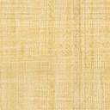

Equation:
To calculate the success
Let consider,
initial cost= i
if shop runs for three months ,take net incomes as x, y, z.
IRR= r.
EQUATION:
$−i∗{\left(1+r\right)}^{3}+x∗{\left(1+r\right)}^{2}+y∗\left(1+r\right)+z=0$
There is one solution in each test case -1< r < 1.

Slide 6

INPUT / OUTPUT:
Input:
The first line of the input gives the number of test cases, T.T test cases follow. Each test case starts with a positive integer M: the number of months that the flower shop will be open. The next line contains M+ 1 non-negative integers Ci(0 ≤ i ≤M). Note that C 0 represents the initial
cost, all the remaining Cis are profits, the shop will always either make a positive net profit or zero net profit in each month, and will never have negative profits.
Output:
For each test case, output one line containing Case #x: y, where x is the test case number (starting from 1) and y is a floating-point number: the IRR of Jane's business . Y will be considered correct if it is within an absolute or relative error of 10-6of the correct answer. See the FAQ for an explanation of what that means, and what formats of real numbers we accept.

Slide 7

ALGORITHMS:
Step 1: Start
Step 2: Take the test cases T,C as initial cost ,M as months.
Step 3: Take M+1 as non-negative integers as int[] C=new int[M+1]
Step 4: Make C as initial cost and for (int i = 0; i < C.length ; ++i)
Step 6: Print the case %.9f, tc to solve C
Step 7: Make middle=(lower+upper)/2 and check if(f(C,middle)<0) upper=middle else lower=middle
Step 8: Calculate it by Math operation: i -> ((i == 0) ? -1 : 1) * C[i] * Math.pow(1 + r, C.length - 1 - i)).sum();
Step 9: Print the case
Step 10: End.

Slide 8
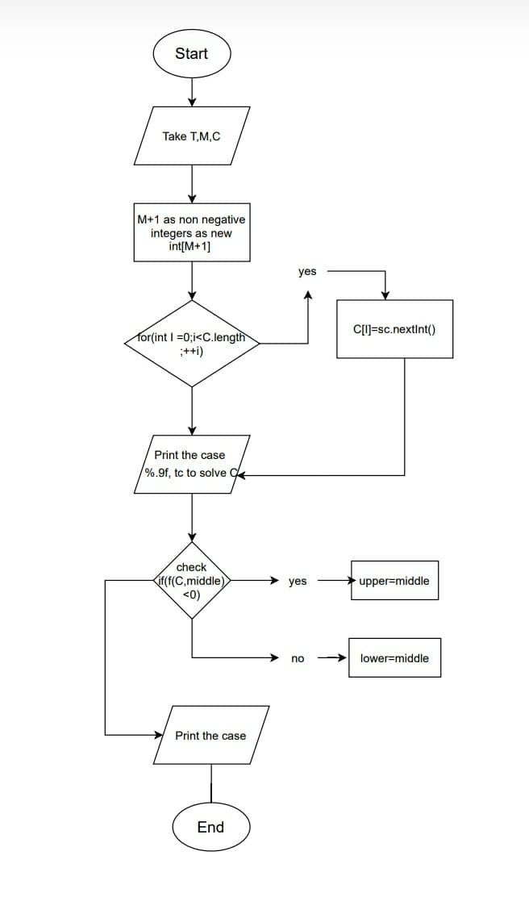
FLOWCHART:

Slide 9
PROGRAM:
#include <iostream>
#include <math.h>
#include <stdio.h>
#include <vector>
using namespace std;
double func(double r, vector<int> M)
{
int n=M.size();
double sum=0-(double)M[0]*pow(1+r,n-1);
for(int i=1;i<n;i++)
sum+=M[i]*pow(1+r,n-i-1);
return sum;
}
double dfunc(double r, vector<int> M)
{
int n=M.size();
double sum=0-(n-1)*M[0]*pow(1+r,n-2);
for(int i=1;i<n;i++)
sum+=(n-i-1)*M[i]*pow(1+r,n-i-2);
return sum; }
int main()
{
int T;
cin>>T;
for(int i=0;i<T;i++)
{
int m;
cin>>m;

Slide 10
PROGRAM:
vector<int> M;
for(int j=0;j<m+1;j++)
{
int tmp;
cin>>tmp;
M.push_back(tmp);
}
double r,tmp;
r=0.5;
tmp=0.5;
r=r-func(r,M)/dfunc(r,M);
while(fabs(tmp-r)>1e-12)
{
tmp=r;
r=r-func(r,M)/dfunc(r,M);
}
printf("Case #%d: %.12f\n",i+1,r);
}
return 0;
}

Slide 11
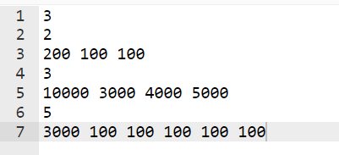
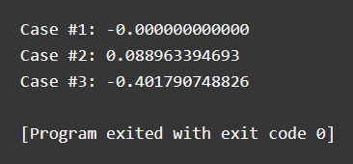
OUTPUT SCREENSHOT:
INPUT SCREENSHOT::

Slide 12
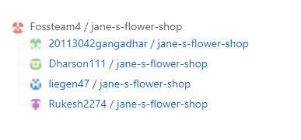
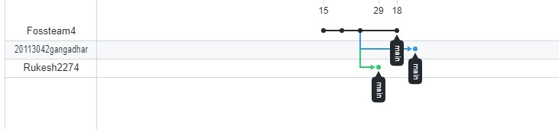
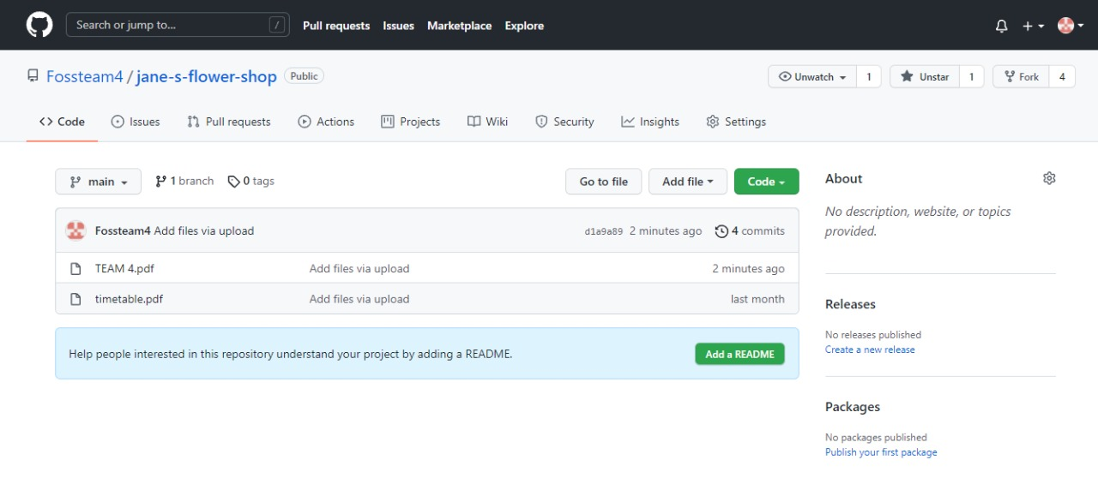
Github screenshot

Slide 13

Thank You

